Slide 1

算法设计与分析 (Algorithm Design and Analysis) 王永才

Slide 2
目录
课程回顾
分治算法
递归算法复杂性分析
主定理

Slide 3
上节课内容回顾
基于归纳法的算法正确性证明
渐进复杂度的证明
最坏情况分析
忽略常数因子和低阶项
渐进分析
基于f(n)与g(n)的不等式关系的渐进复杂性证明
什么样的分治递归方法能够降低计算复杂度？
小学整数乘法的直观分治，不能降低算法复杂度
Karatsuba整数乘法可以降低计算复杂度
基于分治递归树的分治算法复杂性分析
Notes:
F=10^(-11n) g=10^n

Slide 4
分治递归树
将一个大的问题拆成小的问题，递归拆分，计算时先完成最下层问题，再向上递归处理大的问题。
Divide and Conquer:
Big problem
Smaller problem
Smaller problem
Recurse!
Recurse!
Yet smaller problem
Yet smaller problem
Yet smaller problem
Yet smaller problem

Slide 5
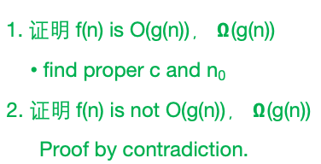
渐进复杂性证明
n³ + 3n = O(n³ – n²)
n³ + 3n = Ω(n³ – n²)
n³ + 3n = Θ(n³ – n²)
3^{n} is NOT O(2^{n})
log₂(n) = Ω(ln(n))
log₂(n) = Θ( 2^{loglog(n)} )
1. 证明 f(n) is O(g(n))， $Ω$(g(n))
find proper c and n₀
2. 证明 f(n) is not O(g(n))， $Ω$(g(n))
Proof by contradiction.
Notes:
C=2, n0=3
C=1, n0=1;
C=1, n0=1

Slide 6
渐进复杂性的四种证明和分析方法
基于分治递归树的复杂性分析
基于f(n)与g(n)的不等式关系的渐进复杂性证明
基于主定理
基于替换法的证明

Slide 7

目录
课程回顾
分治算法
基于递推关系式的复杂性分析
基于主定理
基于递归树分析
基于替换法证明
Mergesort
查找逆序对

Slide 8
MergeSort
6
4
3
8
1
5
2
7
6
4
3
8
1
5
2
7
Recursive magic!
Recursive magic!
3
4
6
8
1
2
5
7
How would you do this in-place?
MERGE!
1
2
3
4
5
6
7
8
Code for the MERGE step is given in the Lecture2 IPython notebook, or the textbook
Ollie the over-achieving Ostrich

Slide 9
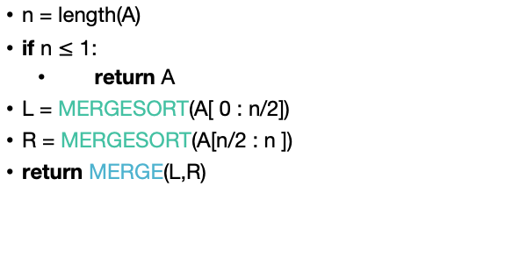
MergeSort Pseudocode
See Lecture 2 IPython notebook for MergeSort Python Code.
MERGESORT(A):
n = length(A)
if n $≤$ 1:
return A
L = MERGESORT(A[ 0 : n/2])
R = MERGESORT(A[n/2 : n ])
return MERGE(L,R)
If A has length 1,
It is already sorted!
Sort the left half
Sort the right half
Merge the two halves
Notes:
Okay, this pseudo-code is actually pretty intuitive, it's follows our english description.
(Question to ponder: what if we wanted to do this in-place?)

Slide 10
The Merge(L, R) step
What the complexity of this algorithm?

Slide 11
What actually happens? First, recursively break up the array all the way down to the base cases
6
4
3
8
1
5
2
7
6
4
3
8
1
5
2
7
6
4
3
8
1
5
2
7
6
4
3
8
1
5
2
7
This array of length 1 is sorted!

Slide 12
Then, merge them all back up!
Sorted sequence!
1
2
3
4
5
6
7
8
Merge!
3
4
6
8
1
2
5
7
Merge!
Merge!
4
6
3
8
1
5
2
7
Merge!
Merge!
Merge!
Merge!
6
4
3
8
1
5
2
7
A bunch of sorted lists of length 1 (in the order of the original sequence).
Notes:
Here's a different way of looking at merge sort. Let's take the same example, and think about it in terms of what order the MERGE calls happen in (instead of what order the recursive calls happen in)

Slide 13
Two questions
Does this work?
Is it fast?
IPython notebook says…
Empirically:
Seems to work.
Seems fast.

Slide 14
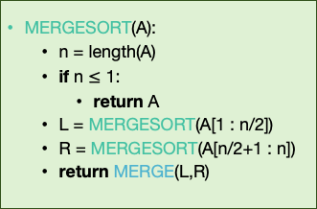
It works
Assume that n is a power of 2 for convenience.
Inductive hypothesis:
“对于任何一个长度为i的数组, MERGESORT可以成功返回一个排序数组.”
Base case (i=1): a 1-element array is always sorted.
Inductive step: 需要证明当对于 k<i成立的话, 对于k=i也成立.
需要证明如果L 和 R是已排序的, 则MERGE(L,R)是已排序的.
Conclusion:在最上层的递归调用中MERGESORT返回一个排序的数组.
MERGESORT(A):
n = length(A)
if n $≤$ 1:
return A
L = MERGESORT(A[1 : n/2])
R = MERGESORT(A[n/2+1 : n])
return MERGE(L,R)
Fill in the inductive step!
HINT: You will need to prove that the MERGE algorithm is correct, for which you may need…another proof by induction!

Slide 15
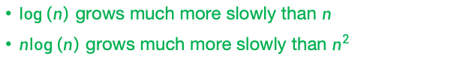
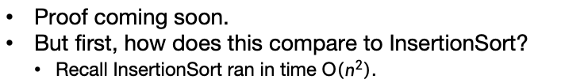

It’s fast
Assume that n is a power of 2 for convenience.
CLAIM:
MergeSort runs in time $O\left(n\log\left(n\right)\right)$
Proof coming soon.
But first, how does this compare to InsertionSort?
Recall InsertionSort ran in time O$\left(n^{2}\right)$.
$\log\left(n\right)$ grows much more slowly than $n$
$n\log\left(n\right)$ grows much more slowly than $n^{2}$

Slide 16
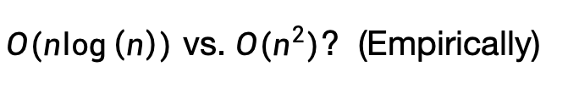
$O(n\log\left(n\right))$ vs. ${O(n}^{2})$? (Empirically)
[See Lecture 2 IPython Notebook for code]
O(n²)
Supposedly O(n logn)

Slide 17
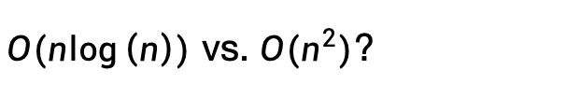

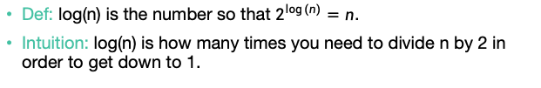
Quick log refresher
$O(n\log\left(n\right))$ vs. ${O(n}^{2})$?
Def: log(n) is the number so that $2^{\log\left(n\right)}=n$.
Intuition: log(n) is how many times you need to divide n by 2 in order to get down to 1.
32, 16, 8, 4, 2, 1
log(32) = 5
$$⇒$$
Halve 5 times
$$⇒$$
log(64) = 6
64, 32, 16, 8, 4, 2, 1
log(128) = 7
log(256) = 8
log(512) = 9
….
log(# particles in the universe) < 280
Halve 6 times
log(n) grows very slowly!

Slide 18
基于分治递归树方法的渐进复杂性证明
Size n
Level 0
n/2
n/2
Level 1
n/4
n/4
n/4
n/4
Focus on just one of these sub-problems
…
Level t
2^{t} subproblems at level t.
n/2^{t}
n/2^{t}
n/2^{t}
n/2^{t}
n/2^{t}
n/2^{t}
…
(Size 1)
Level log(n)

Slide 19
How much work in this sub-problem?
n/2^{t}
Time spent MERGE-ing the two subproblems
+
n/2^{t+1}
n/2^{t+1}
Time spent within the two sub-problems

Slide 20
How much work in this sub-problem?
Let k=n/2^{t}…
k
Time spent MERGE-ing the two subproblems
+
k/2
k/2
Time spent within the two sub-problems

Slide 21
How long does it take to MERGE?
k
Code for the MERGE step is given in the Lecture2 notebook.
k/2
k/2
k/2
k/2
3
4
6
8
1
2
5
7
MERGE!
1
2
3
4
5
6
7
8
k
Answer: It takes time O(k), since we just walk across the list once.

Slide 22
Recursion tree
Size n
n/2
n/2
n/4
n/4
n/4
n/4
…
n/2^{t}
n/2^{t}
n/2^{t}
n/2^{t}
n/2^{t}
n/2^{t}
There are O(k) operations done at this node.
…
k
(Size 1)
k/2
k/2

Slide 23
Recursion tree
Think, Pair, Share!
Size n
How many operations are done at this level of the tree? (Just MERGE-ing subproblems).
n/2
n/2
How about at this level of the tree?
(between both n/2-sized problems)
n/4
n/4
n/4
n/4
This level?
…
This level?
n/2^{t}
n/2^{t}
n/2^{t}
n/2^{t}
n/2^{t}
n/2^{t}
There are O(k) operations done at this node.
…
k
(Size 1)
k/2
k/2

Slide 24
Recursion tree
Work this out yourself!
Size of each
problem
#
problems
Amount of work at this level
Level
Size n
0
1
2
4
2^{t}
n
n
n/2
n/4
n/2^{t}
1
O(n)
O(n)
O(n)
O(n)
O(n)
n/2
n/2
1
n/4
n/4
n/4
n/4
2
…
…
n/2^{t}
n/2^{t}
n/2^{t}
n/2^{t}
n/2^{t}
n/2^{t}
t
…
…
log(n)
(Size 1)

Slide 25
Total runtime…
O(n) steps per level, at every level
log(n) + 1 levels
O( n log(n) ) total!
That was the claim!
To draw a recursion tree to prove the complexity of a division-recursion algorithm.

Slide 26
Another Example
查找数组中的逆序对的问题
输入：数组A，假设其元素各不相同
输出：数组A中逆序对个数（如果对于下标为i，j的两个元素有i<j，但是A[i]>A[j]，则i，j构成一个逆序对。）
An example
一个长度为n的数组中，最多会有多少逆序对呢？

Slide 27
Counting Inversions主要应用
对排序关系的一致性度量
例如你和你的朋友对电影列表各自给出评分，那么计算你和你朋友对电影排名的逆序对数量可以显示你对电影的兴趣差异。
一种直观的方法是直接搜索所有逆序对
这个复杂度是多少？
O(n²)

Slide 28
用分治递归方法求逆序对
6
4
3
8
1
5
2
7
6
4
3
8
1
5
2
7
Left Inversion: 完全在左侧分支的逆序对 3
Right Inversion: 完全在右侧分支的逆序对 1
Split Inversion: 分别处在两个分支的逆序对 3+2+2+4

Slide 29
基于分治递归求逆序对数
难点在于对分离逆序对的计数

Slide 30
站在MergeSort的肩膀上
前面的例子看到，分离逆序对可能有很多，最多的情况是左边都是大的，右边都是小的，则分离逆序对有n²/4个。
想在O(nlogn)的时间内，数出n²/4个逆序对看似不可能。
思路就是站在MergeSort的肩膀上，在MergeSort的Merge过程中，同时进行排序和数逆序对。
这样，每次Merge时，两个子分支都是已经排序好的，我们看如何在Merge的时候，同时数出逆序对个数。

Slide 31
站在MergeSort的肩膀上

Slide 32
Merge and Split Inversions
C
D
1
3
5
2
4
6
B
1
2
3
4
5
6
Number of split inversions
+0
+2
+0
+1
+0
+0
3,5
5

Slide 33
Merge and Split Inversions
对左右两个已经排序的数组进行Merge时，右侧每个数字被放入B数组时，左侧剩余的数字个数，即是与此数字构成的分离逆序对数量。

Slide 34
Complexity Analysis
递归计算过程：
首先，每次调用算法都会调用两个1/2大小的子问题。
然后，递归调用中完成的工作量在输入大小上是线性的。
所以计算时间的递推表达式：
T(n) =2T(n/2) +O(n)
根据分治递归树、或者主定理我们都能证明算法渐进复杂度为 O(nlogn)

Slide 35
目录
课程回顾
分治算法
基于递推关系式的复杂性分析
基于主定理
基于递归树分析
基于替换法证明
Mergesort
查找逆序对

Slide 36


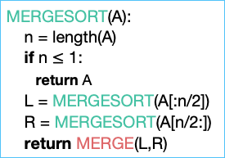
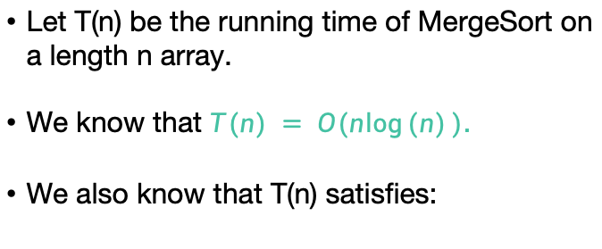
Running time of MergeSort
Let T(n) be the running time of MergeSort on a length n array.
We know that $T(n) = O(n\log{(n)})$.
We also know that T(n) satisfies:
$$T\left(n\right)=2⋅T\left(\frac{n}{2}\right)+O(n)$$
MERGESORT(A):
n = length(A)
if n $≤$ 1:
return A
L = MERGESORT(A[:n/2])
R = MERGESORT(A[n/2:])
return MERGE(L,R)
假设
$$T\left(n\right)≤2⋅T\left(\frac{n}{2}\right)+11⋅n$$

Slide 37
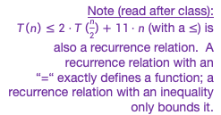
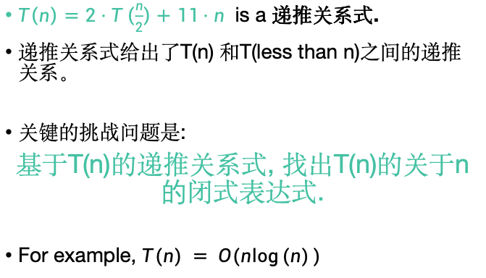
Recurrence Relations
Note (read after class):
$T\left(n\right)≤2⋅T\left(\frac{n}{2}\right)+11⋅n$ (with a $≤$) is also a recurrence relation. A recurrence relation with an “=“ exactly defines a function; a recurrence relation with an inequality only bounds it.
$T\left(n\right)=2⋅T\left(\frac{n}{2}\right)+11⋅n$ is a 递推关系式.
递推关系式给出了T(n) 和T(less than n)之间的递推关系。
关键的挑战问题是:
基于T(n)的递推关系式, 找出T(n)的关于n的闭式表达式.
For example, $T(n) = O(n\log{(n)})$

Slide 38
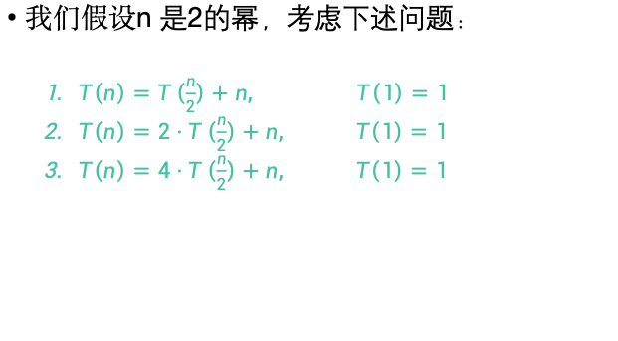
根据递归树分析算法时间复杂度
我们假设n 是2的幂，考虑下述问题：
$T\left(n\right)=T\left(\frac{n}{2}\right)+n, T\left(1\right)=1$
$T\left(n\right)=2⋅T\left(\frac{n}{2}\right)+n, T\left(1\right)=1$
$T\left(n\right)=4⋅T\left(\frac{n}{2}\right)+n, T\left(1\right)=1$

Slide 39
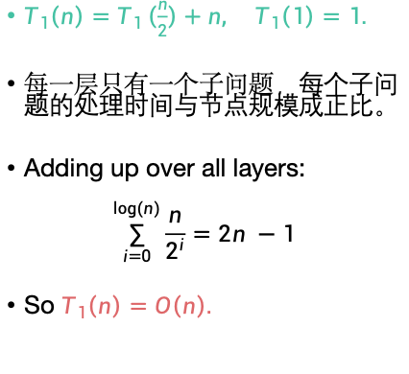
用递归树分析第一个问题
$T_{1}\left(n\right)=T_{1}\left(\frac{n}{2}\right)+n,$ $T_{1}\left(1\right)=1.$
每一层只有一个子问题，每个子问题的处理时间与节点规模成正比。
Adding up over all layers:
$$\sum_{i=0}^{log⁡(n)}{\frac{n}{2^{i}}=2n −1}$$
So $T_{1}\left(n\right)=O\left(n\right).$
Contribution at this layer:
Size n
n
n/2
n/2
n/4
n/4
…
n/2^{t}
n/2^{t}
…
1
(Size 1)
Notes:
Sum (q^n)=(1-q^n)/(1-q)

Slide 40
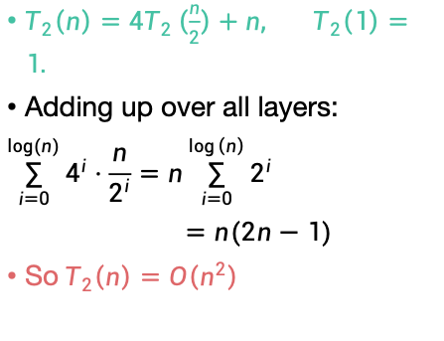
Solutions to pre-lecture exercise (2)
$T_{2}\left(n\right)={4T}_{2}\left(\frac{n}{2}\right)+n,$ $T_{2}\left(1\right)=1.$
Adding up over all layers:
$$\sum_{i=0}^{log⁡(n)}{4^{i}⋅\frac{n}{2^{i}}=n\sum_{i=0}^{\log\left(n\right)}{2^{i}}}$$
$=n(2n−1)$
So $T_{2}\left(n\right)=O\left(n^{2}\right)$
Contribution at this layer:
Size n
n
4x
n/2
2n
16x
n/4
4n
…
4^{t} x
n/2^{t}
2^{t}n
…
n² x
n²
(Size 1)

Slide 41
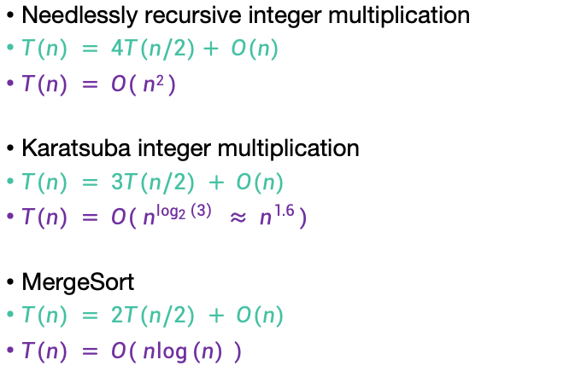
More examples
T(n) = time to solve a problem of size n.
Needlessly recursive integer multiplication
$T(n) = 4T(n/2)+ O(n)$
$T(n) = O( n2 )$
Karatsuba integer multiplication
$T(n) = 3T(n/2) + O(n)$
$T(n) = O( n^{\log_{2}\left(3\right)} ≈ n^{1.6} )$
MergeSort
$T(n) = 2T(n/2) + O(n)$
$T(n) = O( n\log{(n)} )$
This is similar to T₂ from the pre-lecture exercise.
What’s the pattern?!?!?!?!

Slide 42
The master theorem
A useful
formula it is.
Know why it works you should.
A formula for many recurrence relations.
We’ll see an example
Proof: “Generalized” tree method.
Jedi master Yoda

Slide 43



The master theorem
We can also take n/b to mean either $\left\lfloor \frac{n}{b}\right\rfloor$ or $\left\lceil \frac{n}{b}\right\rceil$ and the theorem is still true.
Suppose that $a≥1,b>1,and d$ are constants (independent of n).
Suppose $T\left(n\right)=a⋅T\left(\frac{n}{b}\right)+O\left(n^{d}\right)$. Then
$$T\left(n\right)= \left\{\begin{aligned}O\left(n^{d}\log\left(n\right)\right) if a=b^{d} \\ O\left(n^{d}\right) if a<b^{d} \\ O\left(n^{\log_{b}\left(a\right)}\right) if a>b^{d}\end{aligned}\right.$$
Three parameters:
a : number of subproblems
b : factor by which input size shrinks
d : need to do n^{d} work to create all the subproblems and combine their solutions.
Many symbols those are….

Slide 44


Technicalities II Integer division
Plucky the Pedantic Penguin
If n is odd, I can’t break it up into two problems of size n/2.
However (see CLRS, Section 4.6.2 for details), one can show that the Master theorem works fine if you pretend that what you have is:
From now on we’ll mostly ignore floors and ceilings in recurrence relations.
$$T\left(n\right)=T\left(\left\lfloor \frac{n}{2}\right\rfloor \right)+T\left(\left\lceil \frac{n}{2}\right\rceil \right)+O(n)$$
$$T\left(n\right)=2⋅T\left(\frac{n}{2}\right)+ O(n)$$

Slide 45


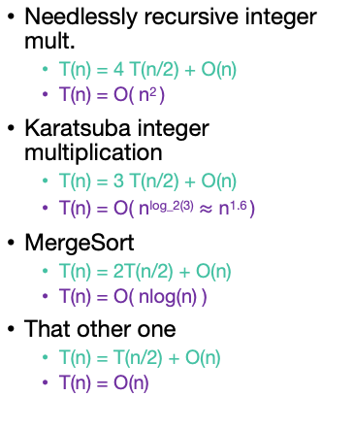
Examples
$T\left(n\right)=a⋅T\left(\frac{n}{b}\right)+O\left(n^{d}\right)$.
$$T\left(n\right)= \left\{\begin{aligned}O\left(n^{d}\log\left(n\right)\right) if a=b^{d} \\ O\left(n^{d}\right) if a<b^{d} \\ O\left(n^{\log_{b}\left(a\right)}\right) if a>b^{d}\end{aligned}\right.$$
Needlessly recursive integer mult.
T(n) = 4 T(n/2) + O(n)
T(n) = O( n² )
Karatsuba integer multiplication
T(n) = 3 T(n/2) + O(n)
T(n) = O( n^{log_2(3)} $≈$ n^{1.6} )
MergeSort
T(n) = 2T(n/2) + O(n)
T(n) = O( nlog(n) )
That other one
T(n) = T(n/2) + O(n)
T(n) = O(n)
✓
a = 4
b = 2
d = 1
a > b^{d}
✓
a = 3
b = 2
d = 1
a > b^{d}
✓
a = 2
b = 2
d = 1
a = b^{d}
✓
a = 1
b = 2
d = 1
a < b^{d}

Slide 46
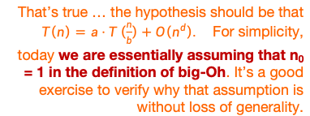

Proof of the master theorem
We’ll do the same recursion tree thing we did for MergeSort, but be more careful.
Suppose that $T\left(n\right)≤a⋅T\left(\frac{n}{b}\right)+c⋅n^{d}$.
Hang on! The hypothesis of the Master Theorem was that the extra work at each level was O(n^{d}), but we’re writing cn^{d}…
That’s true … the hypothesis should be that $T\left(n\right)=a⋅T\left(\frac{n}{b}\right)+O\left(n^{d}\right).$ For simplicity, today we are essentially assuming that n₀ = 1 in the definition of big-Oh. It’s a good exercise to verify why that assumption is without loss of generality.
Plucky the
Pedantic Penguin
Siggi the Studious Stork

Slide 47


Recursion tree
$$T\left(n\right)=a⋅T\left(\frac{n}{b}\right)+c{⋅n}^{d}$$
Amount of work at this level
Size of each
problem
#
problems
Level
Size n
0
1
a
a²
a^{t}
$$a^{\log_{b}\left(n\right)}$$
n
n/b
n/b²
n/b^{t}
1
n/b
n/b
n/b
1
n/b²
n/b²
n/b²
n/b²
2
n/b²
n/b²
n/b²
…
n/b^{t}
n/b^{t}
n/b^{t}
n/b^{t}
n/b^{t}
n/b^{t}
t
…
…
log_{b}(n)
(Size 1)

Slide 48







Recursion tree
$$T\left(n\right)=a⋅T\left(\frac{n}{b}\right)+c{⋅n}^{d}$$
Amount of work at this level
Help me fill this in! How much work at each level?
2 minutes: think How much work total?
1 minute: share (wait)
Size of each
problem
#
problems
Level
Size n
$$c⋅nd$$
0
1
a
a²
a^{t}
$$a^{\log_{b}\left(n\right)}$$
n
n/b
n/b²
n/b^{t}
1
$$ac {\left(\frac{n}{b}\right)}^{d}$$
n/b
n/b
n/b
1
n/b²
n/b²
n/b²
$$a^{2}c {\left(\frac{n}{b^{2}}\right)}^{d}$$
n/b²
2
n/b²
n/b²
n/b²
…
n/b^{t}
n/b^{t}
n/b^{t}
n/b^{t}
n/b^{t}
n/b^{t}
t
$$a^{t}c {\left(\frac{n}{b^{t}}\right)}^{d}$$
…
…
log_{b}(n)
$$a^{\log_{b}\left(n\right)}c$$
(Size 1)
$$a^{\text{log}\text{b}\text{(}\text{n}\text{)}}c {\left(\frac{n}{b^{\text{log}\text{b}\text{(}\text{n}\text{)} }}\right)}^{d}$$
(Let’s pretend that the base case is T(1) = c for convenience).

Slide 49
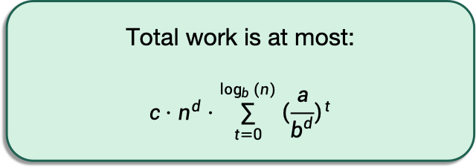





Recursion tree
$$T\left(n\right)=a⋅T\left(\frac{n}{b}\right)+c{⋅n}^{d}$$
Amount of work at this level
Size of each
problem
#
problems
Level
Size n
$$c⋅nd$$
0
1
a
a²
a^{t}
$$a^{\log_{b}\left(n\right)}$$
n
n/b
n/b²
n/b^{t}
1
$$ac {\left(\frac{n}{b}\right)}^{d}$$
n/b
n/b
n/b
1
Total work is at most:
$$c⋅n^{d}⋅\sum_{t=0}^{\log_{b}{(n)}}{{\left(\frac{a}{b^{d}}\right)}^{t}}$$
n/b²
n/b²
n/b²
$$a^{2}c {\left(\frac{n}{b^{2}}\right)}^{d}$$
n/b²
2
n/b²
n/b²
n/b²
…
n/b^{t}
n/b^{t}
n/b^{t}
n/b^{t}
n/b^{t}
n/b^{t}
t
$$a^{t}c {\left(\frac{n}{b^{t}}\right)}^{d}$$
…
…
log_{b}(n)
$$a^{\log_{b}\left(n\right)}c$$
(Size 1)
$$a^{\text{log}\text{b}\text{(}\text{n}\text{)}}c {\left(\frac{n}{b^{\text{log}\text{b}\text{(}\text{n}\text{)} }}\right)}^{d}$$
(Let’s pretend that the base case is T(1) = c for convenience).

Slide 50
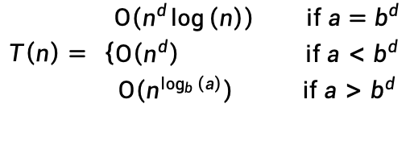
Now let’s check all the cases
$$T\left(n\right)= \left\{\begin{aligned}O\left(n^{d}\log\left(n\right)\right) if a=b^{d} \\ O\left(n^{d}\right) if a<b^{d} \\ O\left(n^{\log_{b}\left(a\right)}\right) if a>b^{d}\end{aligned}\right.$$

Slide 51
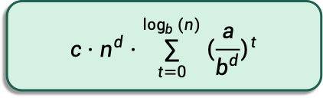
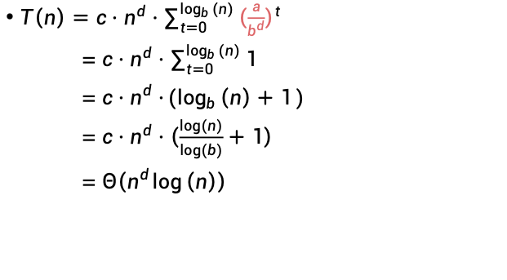
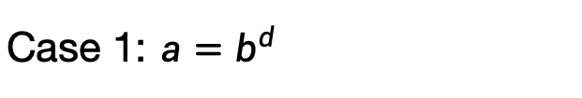
Case 1: $a=b^{d}$
$$c⋅n^{d}⋅\sum_{t=0}^{\log_{b}{(n)}}{{\left(\frac{a}{b^{d}}\right)}^{t}}$$
$$T\left(n\right)= \left\{\begin{aligned}O\left(n^{d}\log\left(n\right)\right) if a=b^{d} \\ O\left(n^{d}\right) if a<b^{d} \\ O\left(n^{\log_{b}\left(a\right)}\right) if a>b^{d}\end{aligned}\right.$$
$T\left(n\right)=c⋅n^{d}⋅\sum_{t=0}^{\log_{b}{(n)}}{{\left(\frac{a}{b^{d}}\right)}^{t}}$
= $c⋅n^{d}⋅\sum_{t=0}^{\log_{b}{(n)}}{1}$
= $c⋅n^{d}⋅(\log_{b}\left(n\right)+1)$
= $c⋅n^{d}⋅\left(\frac{log⁡(n)}{log⁡(b)}+1\right)$
= $Θ\left(n^{d}\log\left(n\right)\right)$
Equal to 1!

Slide 52






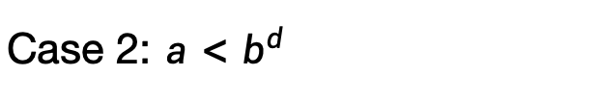
Case 2: $a<b^{d}$
$$T\left(n\right)= \left\{\begin{aligned}O\left(n^{d}\log\left(n\right)\right) if a=b^{d} \\ O\left(n^{d}\right) if a<b^{d} \\ O\left(n^{\log_{b}\left(a\right)}\right) if a>b^{d}\end{aligned}\right.$$
$T\left(n\right)= c⋅n^{d}⋅\sum_{t=0}^{\log_{b}{(n)}}{{\left(\frac{a}{b^{d}}\right)}^{t}}$
Less than 1!
根据级数求和公式：
$T\left(x,N\right)=x^{0}+x^{1}+x^{2}+x^{3}+⋯+x^{N}$= $\frac{{ x}^{N+1}−1}{x−1}$
当1>x>0时：
$$1≤\frac{{ x}^{N+1}−1}{x−1}≤\frac{1}{1−x}$$
$T\left(x,N\right)=Θ\left(1\right)$ $不随着N的增大而变化$
当x>1时：
$$x^{N}≤\frac{{ x}^{N+1}−1}{x−1}≤x^{N}⋅\left(\frac{x}{x−1}\right)$$
$$T\left(x,N\right)= Θ\left(x^{N}\right)$$

Slide 53

Case 2: $a<b^{d}$
$$T\left(n\right)= \left\{\begin{aligned}O\left(n^{d}\log\left(n\right)\right) if a=b^{d} \\ O\left(n^{d}\right) if a<b^{d} \\ O\left(n^{\log_{b}\left(a\right)}\right) if a>b^{d}\end{aligned}\right.$$
$T\left(n\right)= c⋅n^{d}⋅\sum_{t=0}^{\log_{b}{(n)}}{{\left(\frac{a}{b^{d}}\right)}^{t}}$
= $c⋅n^{d}⋅[some constant]$
= $Θ\left(n^{d}\right)$
Less than 1!

Slide 54



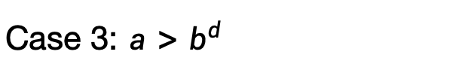
Case 3: $a>b^{d}$
$$T\left(n\right)= \left\{\begin{aligned}O\left(n^{d}\log\left(n\right)\right) if a=b^{d} \\ O\left(n^{d}\right) if a<b^{d} \\ O\left(n^{\log_{b}\left(a\right)}\right) if a>b^{d}\end{aligned}\right.$$
$T\left(n\right)= c⋅n^{d}⋅\sum_{t=0}^{\log_{b}{(n)}}{{\left(\frac{a}{b^{d}}\right)}^{t}}$
= $Θ\left(n^{d}{\left(\frac{a}{b^{d}}\right)}^{\log_{b}{(n)}}\right)$
=$Θ\left(n^{\log_{b}{(a)}}\right)$
Larger than 1!
Convince yourself that this step is legit!
应用换底公式
$${(b^{−d})}^{\log_{b}{n}}=n^{\log_{b}{b^{−d}}}=n^{−d}$$
$${(a)}^{\log_{b}{n}}=n^{\log_{b}{a}}$$

Slide 55
Now let’s check all the cases
$$T\left(n\right)= \left\{\begin{aligned}O\left(n^{d}\log\left(n\right)\right) if a=b^{d} \\ O\left(n^{d}\right) if a<b^{d} \\ O\left(n^{\log_{b}\left(a\right)}\right) if a>b^{d}\end{aligned}\right.$$

Slide 56
Even more generally, for T(n) = aT(n/b) + f(n)…
SLIDE SKIPPED IN CLASS
[From CLRS – you won’t need to know this fancier version for this class unless you want to.]
Figure out how to adapt the proof we gave to prove this more general version!
Ollie the Over-Achieving Ostrich

Slide 57

Understanding the Master Theorem
Let $a≥1,b>1,and d$ be constants.
Suppose $T\left(n\right)=a⋅T\left(\frac{n}{b}\right)+O\left(n^{d}\right)$. Then
$$T\left(n\right)= \left\{\begin{aligned}O\left(n^{d}\log\left(n\right)\right) if a=b^{d} \\ O\left(n^{d}\right) if a<b^{d} \\ O\left(n^{\log_{b}\left(a\right)}\right) if a>b^{d}\end{aligned}\right.$$
What do these three cases mean?

Slide 58
拔河比赛
分支导致问题数量激增！
最多的工作是在树的底部！
树下面的问题更小！最多的工作是在树的顶端！

Slide 59

First example: tall and skinny tree
$T\left(n\right)=T\left(\frac{n}{2}\right)+n, \left(a<b^{d}\right)$
Size n
顶层完成的工作量（最大的问题）远超过了其他地方完成的工作量，在计算复杂性上起决定性作用。
T(n) = O( work at top ) = O(n)
n/2
n/4
n/2^{t}
WINNER
Most work at the top of the tree!
1

Slide 60

Third example: bushy tree
WINNER
$T\left(n\right)=4⋅T\left(\frac{n}{2}\right)+n, \left(a>b^{d}\right)$
Size n
Most work at the bottom of the tree!
n/2
n/2
n/2
n/2
有大量的树叶，总的工作量主要取决于在这些树叶上工作的时间。
T(n) = O( work at bottom ) = O( 4^{depth of tree} ) = O(n²)
1
1
1
1
1
1
1
1
1
1
1
1
1
1
1
1
1
1
1
1
1
1
1
1
1
1
1
1
1
1
1
1
1
1
1
1
1
1
1
1
1
1
1
1
1
1
1
1
1
1
1
1
1
1
1
1
1
1
1
1
1
1
1

Slide 61

Second example: just right
$T\left(n\right)=2⋅T\left(\frac{n}{2}\right)+n, \left(a=b^{d}\right)$
Size n
The branching just balances out the amount of work.
n/2
n/2
The same amount of work is done at every level.
n/4
n/4
n/4
n/4
T(n) = (number of levels) * (work per level)
= log(n) * O(n) = O(n log(n))
TIE!
1
1
1
1
1
1
1
1
1
1

Slide 62
What have we learned?
“主定理”让我们有一套规则可以更轻松的分析算法复杂度。
但它基本上只是归纳了一种计算复杂度的规律，如果我们愿意，我们可以从头开始自己计算。
主定理适用于什么情况呢？
各个分支大小一致的情况。
如果各分支尺寸不一致呢？
替换法

Slide 63
目录
课程回顾
分治算法
递推关系式复杂性分析
基于主定理
基于递归树分析
基于替换法证明
Mergesort
查找逆序对

Slide 64
替换法：The Substitution Method
替换法是另一种解决递归关系的方法。
比主方法更通用。
第一步：对正确答案进行猜测。
第二步：试着证明你的猜测是正确的。
第三步：得到复杂性结果。

Slide 65
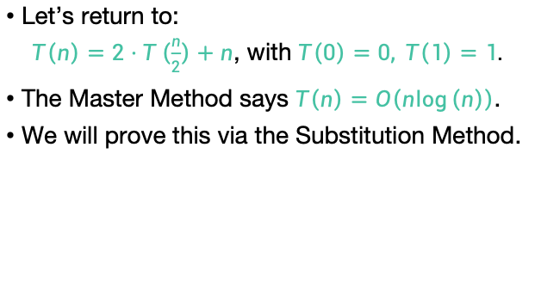
The Substitution Method first example
Let’s return to:
$T\left(n\right)=2⋅T\left(\frac{n}{2}\right)+n$, with $T\left(0\right)=0, T\left(1\right)=1.$
The Master Method says $T\left(n\right)=O\left(n\log\left(n\right)\right)$.
We will prove this via the Substitution Method.

Slide 66
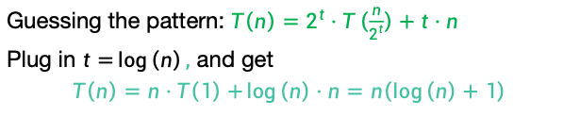


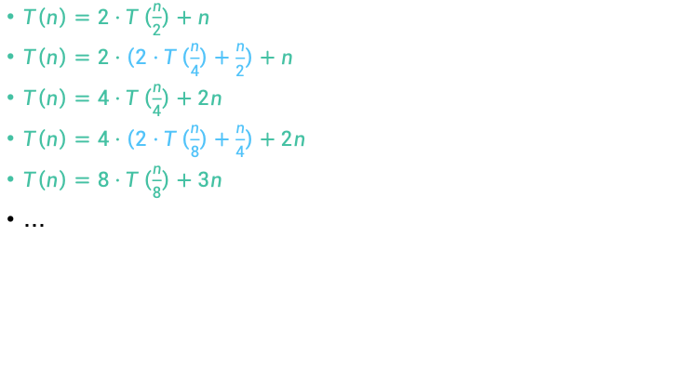
Step 1: Guess the answer
$T\left(n\right)=2⋅T\left(\frac{n}{2}\right)+n$, with $T\left(1\right)=1.$
You can guess the answer however you want: meta-reasoning, a little bird told you, wishful thinking, etc. One useful way is to try to “unroll” the recursion, like we’re doing here.
$T\left(n\right)=2⋅T\left(\frac{n}{2}\right)+n$
$T\left(n\right)=2⋅\left(2⋅T\left(\frac{n}{4}\right)+\frac{n}{2}\right)+n$
$T\left(n\right)=4⋅T\left(\frac{n}{4}\right)+2n$
$T\left(n\right)=4⋅\left(2⋅T\left(\frac{n}{8}\right)+\frac{n}{4}\right)+2n$
$T\left(n\right)=8⋅T\left(\frac{n}{8}\right)+3n$
…
Expand $T\left(\frac{n}{2}\right)$
Simplify
Expand $T\left(\frac{n}{4}\right)$
Simplify
Guessing the pattern: $T\left(n\right)=2^{t}⋅T\left(\frac{n}{2^{t}}\right)+t⋅n$
Plug in $t=\log\left(n\right),$ and get
$$T\left(n\right)=n⋅T\left(1\right)+\log\left(n\right)⋅n=n\left(\log\left(n\right)+1\right)$$

Slide 67
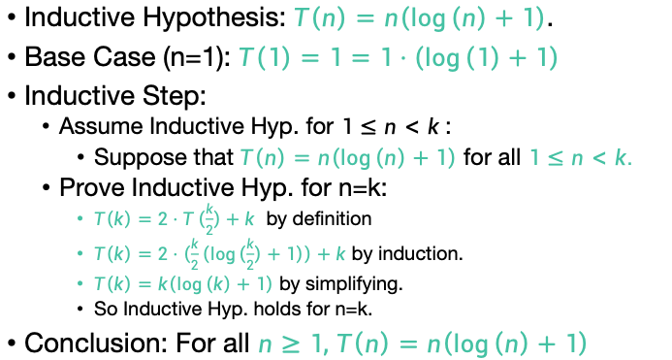
Step 2: Prove the guess is correct.
$T\left(n\right)=2⋅T\left(\frac{n}{2}\right)+n$, with $T\left(1\right)=1.$
Inductive Hypothesis: $T\left(n\right)=n\left(\log\left(n\right)+1\right)$.
Base Case (n=1): $T\left(1\right)=1=1⋅\left(\log\left(1\right)+1\right)$
Inductive Step:
Assume Inductive Hyp. for $1≤n<k$:
Suppose that $T\left(n\right)=n\left(\log\left(n\right)+1\right)$ for all $1≤n<k.$
Prove Inductive Hyp. for n=k:
$T\left(k\right)=2⋅T\left(\frac{k}{2}\right)+k$ by definition
$T\left(k\right)=2⋅\left(\frac{k}{2}\left(\log\left(\frac{k}{2}\right)+1\right)\right)+k$ by induction.
$T\left(k\right)=k\left(\log\left(k\right)+1\right)$ by simplifying.
So Inductive Hyp. holds for n=k.
Conclusion: For all $n≥1,$ $T\left(n\right)=n\left(\log\left(n\right)+1\right)$
We’re being sloppy here about floors and ceilings…what would you need to do to be less sloppy?

Slide 68
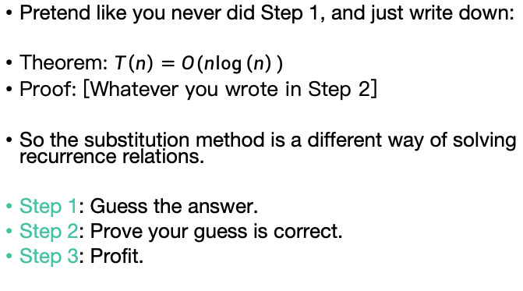
Step 3: Profit
Pretend like you never did Step 1, and just write down:
Theorem: $T\left(n\right)=O(n\log\left(n\right))$
Proof: [Whatever you wrote in Step 2]
So the substitution method is a different way of solving recurrence relations.
Step 1: Guess the answer.
Step 2: Prove your guess is correct.
Step 3: Profit.

Slide 69
What have we learned?
The substitution method is a different way of solving recurrence relations.
Step 1: Guess the answer.
Step 2: Prove your guess is correct.
Step 3: Profit.
We’ll get more practice with the substitution method next lecture!

Slide 70
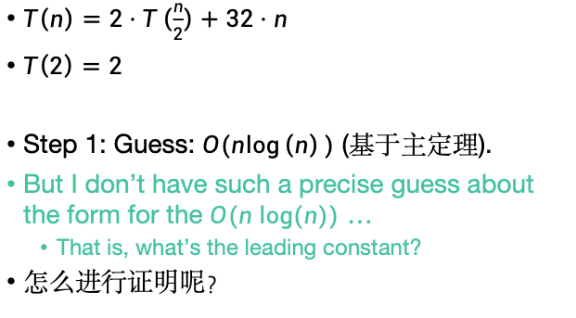
另外一个例子
(If not time, that’s okay; we’ll see these ideas in Lecture 4)
$T\left(n\right)=2⋅T\left(\frac{n}{2}\right)+32⋅n$
$T\left(2\right)=2$
Step 1: Guess: $O(n\log\left(n\right))$ (基于主定理).
But I don’t have such a precise guess about the form for the $O(n log⁡(n))$ …
That is, what’s the leading constant?
怎么进行证明呢？

Slide 71
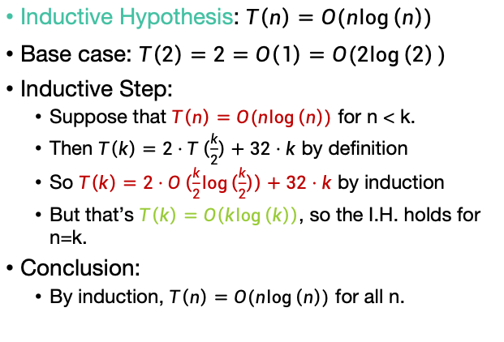
下述证明是正确的么？
Inductive Hypothesis: $T\left(n\right)=O(n\log\left(n\right))$
Base case: $T\left(2\right)=2=O\left(1\right)=O(2\log\left(2\right))$
Inductive Step:
Suppose that $T\left(n\right)=O(n\log\left(n\right))$ for n < k.
Then $T\left(k\right)=2⋅T\left(\frac{k}{2}\right)+32⋅k$ by definition
So $T\left(k\right)=2⋅O\left(\frac{k}{2}\log\left(\frac{k}{2}\right)\right)+32⋅k$ by induction
But that’s $T\left(k\right)=O\left(k\log\left(k\right)\right)$, so the I.H. holds for n=k.
Conclusion:
By induction, $T\left(n\right)=O(n\log\left(n\right))$ for all n.
这样证明是错误的，如果这样证明的话，所有假设都可以证明出来

Slide 72
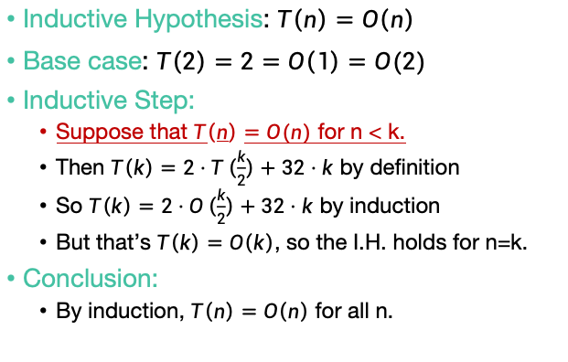
这种证明方式是不对的
我们可以用流程同样证明T(n)=O(n)
Inductive Hypothesis: $T\left(n\right)=O\left(n\right)$
Base case: $T\left(2\right)=2=O\left(1\right)=O(2)$
Inductive Step:
Suppose that $T\left(n\right)=O(n)$ for n < k.
Then $T\left(k\right)=2⋅T\left(\frac{k}{2}\right)+32⋅k$ by definition
So $T\left(k\right)=2⋅O\left(\frac{k}{2}\right)+32⋅k$ by induction
But that’s $T\left(k\right)=O\left(k\right)$, so the I.H. holds for n=k.
Conclusion:
By induction, $T\left(n\right)=O\left(n\right)$ for all n.
问题是这个假设没有任何意义。我们不能
设“T(n)=O(n)，对于n<k”, 因为big Oh的定义需要对n>n₀所有n成立。

Slide 73

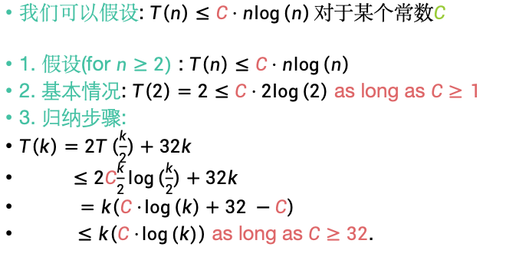
如何证明呢？
我们可以假设: $T\left(n\right)≤C⋅n\log\left(n\right)对于某个常数C$
1. 假设(for $n≥2)$ : $T\left(n\right)≤C⋅n\log\left(n\right)$
2. 基本情况: $T\left(2\right)=2≤C⋅2\log\left(2\right)$ as long as $C≥1$
3. 归纳步骤:
$T\left(k\right)=2T\left(\frac{k}{2}\right)+32k$
$≤2C\frac{k}{2}log\left(\frac{k}{2}\right)+32k$
$=k\left(C⋅\log\left(k\right)+32 −C\right)$
$≤k\left(C⋅\log{(k)}\right)$ as long as $C≥32$.
所以，当$C≥32$时上述假设对所有n成立
$$T\left(n\right)=2⋅T\left(\frac{n}{2}\right)+32⋅n$$
$$T\left(2\right)=2$$

Slide 74
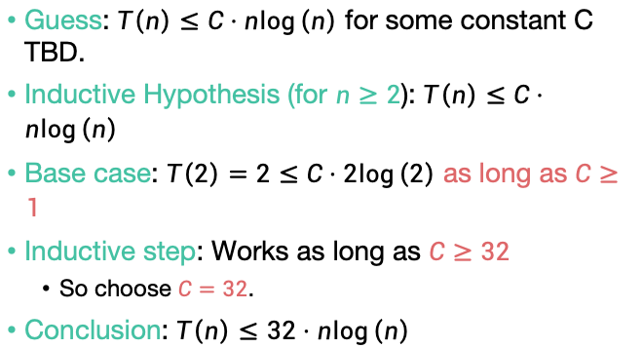
Step 2: 假设一个常数项，反向推导出这一常数项
Guess: $T\left(n\right)≤C⋅n\log\left(n\right)$ for some constant C TBD.
Inductive Hypothesis (for $n≥2$): $T\left(n\right)≤C⋅n\log\left(n\right)$
Base case: $T\left(2\right)=2≤C⋅2\log\left(2\right)$ as long as $C≥1$
Inductive step: Works as long as $C≥32$
So choose $C=32$.
Conclusion: $T\left(n\right)≤32⋅n\log\left(n\right)$
$$T\left(n\right)=2⋅T\left(\frac{n}{2}\right)+32⋅n$$
$$T\left(2\right)=2$$

Slide 75
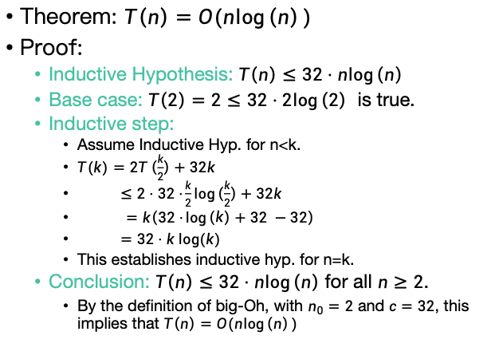
Step 3: 正式证明过程
Theorem: $T\left(n\right)=O(n\log\left(n\right))$
Proof:
Inductive Hypothesis: $T\left(n\right)≤32⋅n\log\left(n\right)$
Base case: $T\left(2\right)=2≤32⋅2\log\left(2\right)$ is true.
Inductive step:
Assume Inductive Hyp. for n<k.
$T(k)=2T\left(\frac{k}{2}\right)+32k$
$≤2⋅32⋅\frac{k}{2}log\left(\frac{k}{2}\right)+32k$
$=k\left(32⋅\log\left(k\right)+32 −32\right)$
$=32⋅k log⁡(k)$
This establishes inductive hyp. for n=k.
Conclusion: $T\left(n\right)≤32⋅n\log\left(n\right)$ for all $n≥2$.
By the definition of big-Oh, with $n_{0}=2$ and $c=32$, this implies that $T\left(n\right)=O(n\log\left(n\right))$
By the def. of T(k)
By induction

Slide 76


为什么需要替换法呢？
有时主定理并不能使用。
如果每次拆出的问题是大小不相等的几个问题时，主定理不能使用，这时需要使用替换法证明.
主定理适用情况：一个大问题递归拆成a个同等大小子问题
$$T\left(n\right)=a⋅T\left(\frac{n}{b}\right)+O\left(n^{d}\right)$$
$$T\left(n\right)=T\left(\frac{n}{3}\right)+T\left(\frac{2n}{3}\right)+O\left(n\right)$$

Slide 77
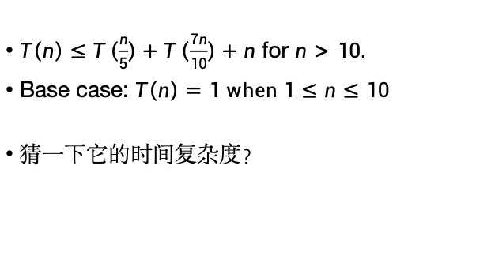
我们再看一个例子
$T\left(n\right)≤T\left(\frac{n}{5}\right)+T\left(\frac{7n}{10}\right)+n$ for $n>10.$
Base case: $T\left(n\right)=1 when 1≤n≤10$
猜一下它的时间复杂度？

Slide 78

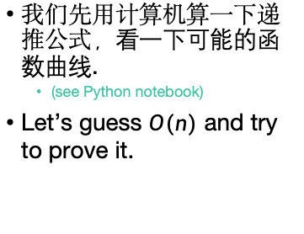
Step 1: 猜测答案
$$T\left(n\right)≤T\left(\frac{n}{5}\right)+T\left(\frac{7n}{10}\right)+n \text{for} n>10.$$
$$\text{Base} \text{case}\text{: }T\left(n\right)= 1 when 1≤n≤10$$
我们先用计算机算一下递推公式，看一下可能的函数曲线.
(see Python notebook)
Let’s guess $O(n)$ and try to prove it.
Looks pretty linear?

Slide 79



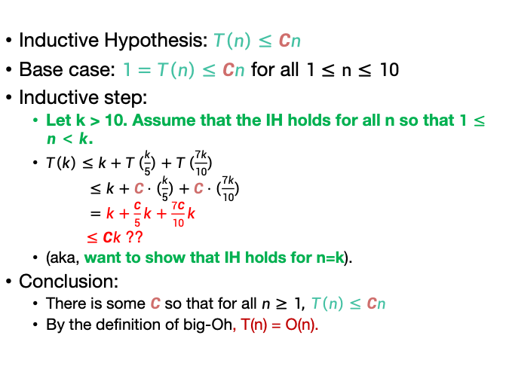
Step 2: 归纳法证明
We don’t know what C should be yet! Let’s go through the proof leaving it as “C” and then figure out what works…
$$T\left(n\right)≤T\left(\frac{n}{5}\right)+T\left(\frac{7n}{10}\right)+n \text{for} n>10.$$
$$\text{Base} \text{case}\text{: }T\left(n\right)= 1 when 1≤n≤10$$
Inductive Hypothesis: $T\left(n\right)≤Cn$
Base case: $1=T\left(n\right)≤Cn$ for all $1≤n≤10$
Inductive step:
Let k > 10. Assume that the IH holds for all n so that $1≤n<k$.
$T\left(k\right)≤k+T\left(\frac{k}{5}\right)+T\left(\frac{7k}{10}\right)$
$≤k+C⋅\left(\frac{k}{5}\right)+C⋅\left(\frac{7k}{10}\right)$
$=k+\frac{C}{5}k+\frac{7C}{10}k$
$≤Ck$ ??
(aka, want to show that IH holds for n=k).
Conclusion:
There is some $C$ so that for all $n≥1, T\left(n\right)≤Cn$
By the definition of big-Oh, T(n) = O(n).
Whatever we choose C to be, it should have C$≥$1
$$k+\frac{C}{5}k+\frac{7C}{10}k≤Ck$$
10+9C $≤10C$
C $≥$ 10 works.

Slide 80


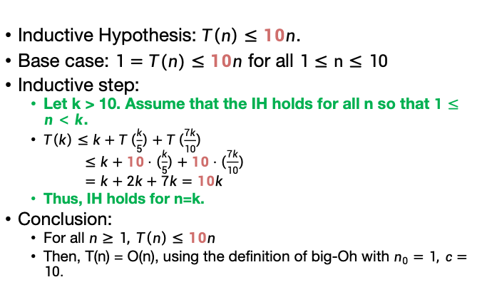
Step 3: Profit
$$T\left(n\right)≤n+T\left(\frac{n}{5}\right)+T\left(\frac{7n}{10}\right) \text{for} n>10.$$
$$\text{Base} \text{case}\text{: }T\left(n\right)= 1 when 1≤n≤10$$
(Aka, pretend we knew this all along).
Theorem: $T\left(n\right)=O\left(n\right)$
Proof:
Inductive Hypothesis: $T\left(n\right)≤10n$.
Base case: $1=T(n)≤10n$ for all $1≤n≤10$
Inductive step:
Let k > 10. Assume that the IH holds for all n so that $1≤n<k$.
$T\left(k\right)≤k+T\left(\frac{k}{5}\right)+T\left(\frac{7k}{10}\right)$
$≤k+10⋅\left(\frac{k}{5}\right)+10⋅\left(\frac{7k}{10}\right)$
$=k+2k+7k$ $=10k$
Thus, IH holds for n=k.
Conclusion:
For all $n≥1, T\left(n\right)≤10n$
Then, T(n) = O(n), using the definition of big-Oh with $n_{0}=1, c=10.$

Slide 81


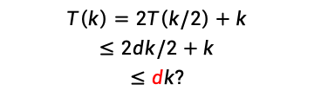
替换法证明可能碰到的问题
现在我们将尝试一个我们的猜测不正确的例子。考虑递归T(n)=2T(n/2)+n（类似于MergeSort）。但是我们将猜测该算法是线性的。
猜测
假设对于所有$1≤$n<k上述不等式成立
$$T\left(k\right)=2T\left(k/2\right)+k$$
$$≤2dk/2+k$$
$$≤dk?$$
要证明T(k)小于等于dk，在n=k时成立
$$dk+k≤dk$$
$$k≤0$$
不成立，找不到这样的d，因为前面假设错误了，所以替换法证不出来

Slide 82





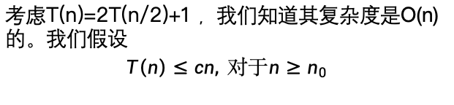
替换法证明可能碰到的问题
有时渐进复杂性猜对了，但是替换法却证明不出。
考虑T(n)=2T(n/2)+1 ，我们知道其复杂度是O(n)的。我们假设
$$T\left(n\right)≤cn, 对于n≥n_{0}$$
假设对于所有$1≤$n<k上述不等式成立，我们要证明n=k时成立
$$T\left(k\right)=2T\left(k/2\right)+1$$
$$≤2ck/2+1≤ck?$$
$$1≤0$$
$$ck+1≤ck$$
不成立
这时，并不意味着假设O(n)是错误的，而是可以调整假设的不等式： $T\left(n\right)≤cn$-1，解决常数部分带来的影响

Slide 83




替换法证明可能碰到的问题
我们假设
$$T\left(n\right)≤cn−1, 对于n≥n_{0}$$
假设对于所有$1≤$n<k上述不等式成立，我们要证明n=k时成立
$$T\left(k\right)=2T\left(k/2\right)+1$$
$$≤2\left(\frac{ck}{2}−1\right)+1≤ck−1?$$
$$ck−1≤ck−1$$
对于任意c成立。
这样我们假设$T\left(n\right)≤n−1$。重写正式证明过程即可。

Slide 84



总结：分治递归的复杂性分析
主定理
替换法
假设$T\left(n\right)≤Cg\left(n\right)，$推导出常数C，再给出$T\left(n\right)=O(g(n))$的整个证明。
$$T\left(n\right)=a⋅T\left(\frac{n}{b}\right)+O\left(n^{d}\right)$$
$$T\left(n\right)= \left\{\begin{aligned}O\left(n^{d}\log\left(n\right)\right) if a=b^{d} \\ O\left(n^{d}\right) if a<b^{d} \\ O\left(n^{\log_{b}\left(a\right)}\right) if a>b^{d}\end{aligned}\right.$$

Slide 85
目录
课程回顾
分治算法
递推关系式复杂性分析
基于主定理
基于递归树分析
基于替换法证明
Mergesort
查找逆序对
常见的分治递归算法

Slide 86

常见递归和分治算法（比较慢的）
整数全排列
$$perm\left(R\right)=\left\{\begin{matrix}[r], if n==1 \\ {[r}_{1}perm\left(R_{1}\right),r_{2}perm\left(R_{2}\right),…r_{n}perm\left(R_{n}\right)], if n>1\end{matrix}\right.$$
$$T\left(n\right)=nT\left(n−1\right)+O\left(n\right)$$
整体计算复杂度是多少？
2. 菲波那切数列
$$fib\left(n\right)=\left\{\begin{matrix}1, if n≤1 \\ fib\left(n−1\right)+fib\left(n−2\right), if n>1\end{matrix}\right.$$
$$T\left(n\right)=T\left(n−1\right)+T\left(n−2\right)+O\left(1\right)$$
复杂度是多少？

Slide 87


常见递归和分治算法（未优化的）
整数除法：不允许使用”/, *, %”的。
$$Div\left(n,x\right)=\left\{\begin{matrix}0, if n<x \\ \begin{aligned}1, if n=x \\ 1+Div\left(n−x,x\right), if n>x\end{aligned}\end{matrix}\right.$$
整数阶乘
$$factorial\left(n\right)=\left\{\begin{matrix}1, if n==0 \\ n∙factorial\left(n−1\right), if n≥1\end{matrix}\right.$$
$$T\left(n\right)=T\left(n−1\right)+O\left(1\right)$$
复杂度是多少？
$$T\left(n\right)=T\left(n−x\right)+O\left(1\right)$$
整体计算复杂度是多少？

Slide 88



常见递归和分治算法
求整数的幂
$$pow\left(x,n\right)=\left\{\begin{matrix}1, if n=0 \\ x∗pow\left(x,n−1\right), if n>0\end{matrix}\right.$$
$$pow\left(x,n\right)=\left\{\begin{matrix}\begin{aligned}1, if n=0 \\ x, if n=1 \\ x∗x if n=2\end{aligned} \\ \begin{aligned}pow\left(x,\frac{n}{2}\right)∗pow\left(x,\frac{n}{2}\right),if n\%2=0 \\ pow\left(x,\frac{n}{2}\right)∗pow\left(x,\frac{n}{2}\right)∗x, if n\%2=1\end{aligned}\end{matrix}\right.$$
$$T\left(n\right)=T\left(n−1\right)+O\left(1\right)$$
$$T\left(n\right)=T\left(n/2\right)+O\left(1\right)$$

Slide 89

常见递归和分治算法(比较快的)
归并排序
MERGESORT(A):
n = length(A)
if n $≤$ 1:
return A
L = MERGESORT(A[ 0 : n/2])
R = MERGESORT(A[n/2 : n ])
return MERGE(L,R)
$$T\left(n\right)=2T\left(n/2\right)+O\left(n\right)$$

Slide 90

常见递归和分治算法(比较快的)
二分查找
$$bsearch\left(A,l,r,x\right)=\left\{\begin{matrix}mid, if A\left[mid\right]=x \\ \begin{aligned}bsearch\left(A,mid+1,r,x\right), if A\left[mid\right]>x \\ bsearch\left(A,l,mid−1,x\right), if A\left[mid\right]<x\end{aligned}\end{matrix}\right.$$
$$T\left(n\right)=T\left(n/2\right)+O\left(1\right)$$
整体计算复杂度是多少？
快速排序
线性时间选择
矩阵乘法
平面最近点对
循环赛日程表…

Slide 91
作业
算法详解教材的 1.2，1.3，1.4, 1.5，2.1, 2.2, 2.3, 2.4, 2.5
Yoj上分治递归方面的题目: 909, 910, 911, 784,785, 786 (都可以做了)

